Slide 1



LQHD 023 supplement 2
A Case Study:
XLA BufferAssignment
Garfee
2020.04.07

Slide 2
Disclaimer:
I did not actually work on XLA BufferAssignment
So if I made mistake, please give me feedback.
What is XLA
And why should we do static analysis about memory
Base on tensorflow 1.14

Slide 3
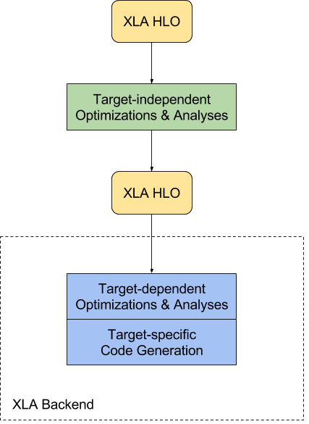
What is XLA
XLA is the backend of AI computation
Short for “Accelerated Linear Algebra”
Born: XLA - TensorFlow, compiled. Mar. 6th, 2017
XLA is a domain-specific compiler for linear algebra that can accelerate Tensorflow models
Also support Tensorflow, Pytorch, JAX, Julia front-end by far

Slide 4
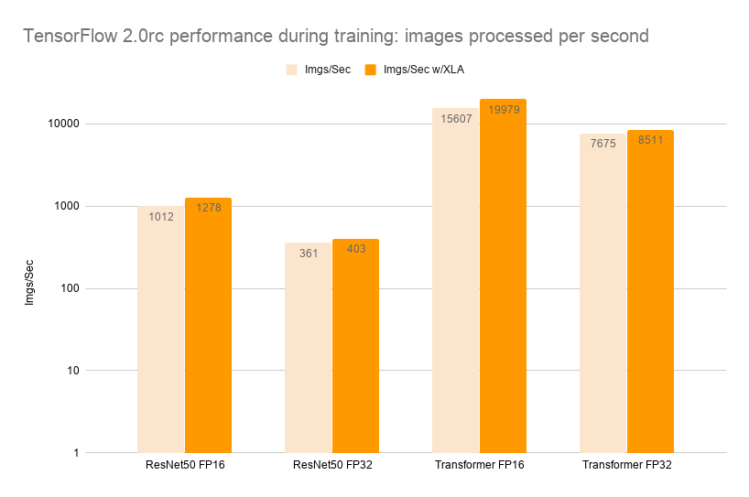
Strength of XLA upon accelerators
Performance: Improve execution speed
Traditional compiler methods: CSE, DCE, constant propagation…
Layout transformation: benefit specific hardware…
Kernel fusion: eliminate overhead of data move…
Etc…
Improve memory usage.
Analyze and schedule memory usage, in principle eliminating many intermediate storage buffers.
A method: BufferAssignment in XLA.
Visit: https://www.tensorflow.org/xla for more details

Slide 5
Some brief introduction into XLA
def simple(…):
a = tf.placeholder(type, shape=…)
b = tf.placeholder(type, shape=…)
c = a + b
d = b + 1
e = c * d
…
sess.run(e, feed_dict)
XLA works on the computational graph of AI models
But in an “almost-SSA-formed IR” representation: HLO
Some SSA exception on “While/Condition”, etc.
Each HLO IR is an operation
Mapped to the node of the computational graph
minimal primitives which XLA operates on (operation)
Will be lowered to “kernel code” on accelerator
Computational graph
e = c * d
c = a + b
d = b + 1
a
b
HLO
ENTRY simple_computation(…) {
a = …
b = …
c = add(a, b)
const = constant(1)
d = add(b, const)
e = multiply(c, d)
…
}

Slide 6
Some brief introduction into XLA
def simple(…):
a = tf.placeholder(type, shape=…)
b = tf.placeholder(type, shape=…)
c = a + b
d = b + 1
e = c * d
…
sess.run(e, feed_dict)
The “almost-SSA-formed” IR representation: HLO
Constness of variable in language level or computation graph nature creates SSA directly
variable can only be initialized (no assignment)
Node in computational graph is unique
Recall: SSA advantage from static program analysis’ perspective:
shorter live interval
explicit Def-Use relationship
Computational graph
e = c * d
c = a + b
d = b + 1
a
b
HLO
ENTRY simple_computation(…) {
a = …
b = …
c = i32[1] add(i32[1] a, i32[1] b)
const = i32[1] constant(1)
d = add(i32[1] b, i32[1] const)
e = multiply(i32[1] c, i32[1] d)
…
}
If it is not SSA, it still can be converted to. Still remember how to create SSA-formed IR?
Go back to “Static Single Assignment Form” of DCC888 in case you forget (https://homepages.dcc.ufmg.br/~fernando/classes/dcc888/ementa/slides/StaticSingleAssignment.pdf)
DOM set - Dominators
DF set - Dominator Frontier
Insert phi-function to DF+ set - Iterated Dominator Frontier
Variable renaming

Slide 7


Because we can
The natural of static computational graph gives us the chance
Tensors occupies fixed amount of memory.
The computational graph is decided statically (ahead of execution).
Advantage over pure dynamic memory allocation
Pure dynamic memory allocation of operations:
Allocate each time executing a kernel.
Heavy memory management & fragmentation.
XLA static memory analysis:
Many memory requirement are grouped up. Each operation fetches its memory by offset, which means it reuses memory from other operations.
Less fragmentation and memory management since it sees full picture.
Limitation:
May not apply to dynamic computation graph
So why do static analysis about memory

Slide 8
XLA BufferAssignment – my reading
Target: reuse memory as much as possible
Maybe that is why it is called “Buffer”.
Each operation is assigned with an output memory (buffer)
Simple rule: live intervals of the buffers do not interfere can be assigned overlapping buffer
If current buffer interferes with all assignment, create a new allocation for it.
Finally, group all the allocated memory together

Slide 9
Where does alias come from?
a = f32[5] …
Notions:
An operation in XLA commonly defines >=1 Buffers.
Put the operation output into such buffer(s)/memory.
We use “buffer(inst, {})”, etc to depict the buffer the “inst” refers to.
Solving disasmbiguity
Buffer pointed by HLO may alias to the other
Or to say, 2 computation may define same buffer.
Some XLA operations does not create new data (like tuple, bitcast, get-tuple-element)
It defines single buffer:
buffer(a, {})
b = (f32 [], s32[]) …
It defines 3 buffers:
buffer(b, {})
buffer(b, {0})
buffer(b, {1})

Slide 10
Where does alias come from?
a = …
b = …
Alias example: tuple can create alias
XLA_computation(…) {
a = …
b = …
…
c = tuple (a, b)
d = get-tuple-element(c, 1)
…
… = d
}
c = tuple(a, b)
d = get-tuple-element(c, 1)
… = d
It is obvious that, “buffer(d, {})” is an alias of “buffer(b, {})”, from the perspective of buffer they use.
(Note: “buffer(c, {1})” also belongs to this alias set)
tuple: group in multiple buffers
get-tuple-element: fetch buffer piece from tuple by index
For more, visit: https://www.tensorflow.org/xla/operation_semantics

Slide 11
How to do alias analysis in XLA
a = …
b = …
Alias Analysis in XLA
First, define all the logical buffers.
A logical buffer is a buffer instance.
A simple scan (in topological order) creates logical buffer for each instruction.
c = tuple(a, b)
d = get-tuple-element(c, 1)
Notice here, it defines that “get-tuple-element” do not generate logical buffer
… = d
Buffer aliases:
Buffer(a, {}) : [ (a, {}) ]
Buffer(b, {}) : [ (b, {}) ]
Buffer(c, {}) : [ (c, {})]

Slide 12
How to do alias analysis in XLA
a = …
b = …
Alias Analysis in XLA
First, define all the logical buffers.
A logical buffer is a buffer instance.
A simple linear scan (in topological order) creates logical buffer for each instruction.
Instruction-wise alias creation
The Def-Use relationship is explicit.
The alias relationship can be searched using DU/UD.
c = tuple(a, b)
d = get-tuple-element(c, 1)
… = d
Buffer aliases:
Buffer(a, {}) : [ (c, {0}), (a, {}) ]
Buffer(b, {}) : [ (c, {1}), (b, {}) ]
Buffer(c, {}) : [ (c, {})]

Slide 13
How to do alias analysis in XLA
a = …
b = …
Alias Analysis in XLA
First, define all the logical buffers.
A logical buffer is a buffer instance.
A simple linear scan (in topological order) creates logical buffer for each instruction.
Instruction-wise alias creation
The Def-Use relationship is explicit.
The alias relationship can be searched using DU/UD.
Following a topological order and do it iteratively
Without considering any loop, the analysis will reach a fixed point quickly
c = tuple(a, b)
d = get-tuple-element(c, 1)
… = d
Buffer aliases:
Buffer(a, {}) : [ (c, {0}), (a, {}) ]
Buffer(b, {}) : [ (c, {1}), (b, {}), (d, {}) ]
Buffer(c, {}) : [ (c, {})]

Slide 14
How to do alias analysis in XLA
a = …
b = …
Alias Analysis in XLA
Finally, populate the point-to mapping and buffer-alias mapping
c = tuple(a, b)
buffer(a, {})
buffer(b, {})
buffer(c, {})
a
b
c
d
Point-to-set
d = get-tuple-element(c, 1)
buffer-alias
… = d
[ buffer(a, {}) ]
[ buffer(b, {}) ]
…
[ (c, {0}), (a, {}) ]
[ (c, {1}), (b, {}), (d, {}) ]
[ (c, {})]
Can you figure out more mapping here?

Slide 15
How to do alias analysis in XLA
Further, some inter-procedure things must be considered
If expecting it could reveal the reuse of buffers between computations
(Something interesting)
Nature loops are modeled in DSL-level
Together with “almost-SSA-form”, it make compiler work extremely easy to go with
a = …
b = …
c = tuple(a, b)
while(…, c)
while_computation(…, c) {
d = get-tuple-element(c, 1)
…
… = d
}

Slide 16
Next to consider
a = …
b = …
Back to the problem: Does a buffer assignment reuse an allocation or need fresh allocation
Is it going to build live interval or interference graph?
Not really
We still need to know if the live intervals interfere
But the interference depends on how to execute the computation graph
In sequential order
Multi-threaded execution
c = tuple(a, b)
d = get-tuple-element(c, 1)
e = d
Can buffer(e, {}) re-use buffer(a, {})?

Slide 17
Sequential execution
buffer(a, {})
buffer(b, {})
buffer(c, {})
buffer(e, {})
a = …
b = …
a = …
b = …
c = tuple(a, b)
d = get-tuple-element(c, 1)
e = d
e = d
Can buffer(d, {}) re-use buffer(a, {})?
Can you recall the topics about reverse-postorder, depth-first-spanning-tree, linear scan, etc?

Slide 18
Sequential execution
Note: whether buffer(e, {}) can re-use buffer(b, {}) depends on how operation “e = d” is lowered.
buffer(a, {})
buffer(b, {})
buffer(c, {})
buffer(e, {})
a = …
b = …
a = …
b = …
c = tuple(a, b)
d = get-tuple-element(c, 1)
e = d
e = d
Can buffer(d, {}) re-use buffer(a, {})?
If it is sequential, we may build live intervals to reveal the interference. That means it could have similar defect as linear scan register allocation.
However, a more severe issue is that it does not work for threaded execution

Slide 19
Multi-threaded execution
A multiple threaded execution of computation graph
One XLA strategy is to allocate each GEMM operation to a GPU stream (hw thread)
Since GEMM is commonly the main course of AI computation.
a = …
b = …
e = d
Can buffer(d, {}) re-use buffer(a, {})?

Slide 20
Multi-threaded execution
A multiple threaded execution of computation graph
XLA BufferAssignment accepts a “pre-coloring” of HLOs
Coloring? Not same concept of coloring in RA.
it is just grouping.
HLOs in same stream may have chance to re-use buffer.
An earlier pass “StreamAssignment” would assign “stream-id” to each of the HLO
It is feasible to assign each HLO within same stream group the same color.
HLOs which are not allocated in same color would simply be considered as live interval interfere.
a = …
b = …
e = d
Can buffer(d, {}) re-use buffer(a, {})?
No for the color. Even the live interval does not interfere

Slide 21
Liveness Interference
buffer(a, {})
buffer(b, {})
buffer(c, {})
buffer(e, {})
So can we just use this “pre-color” and do linear scan to complete buffer allocation?
Note that it assumes there is infinite buffer to assign (and no “spilling” is required)
a = …
b = …
buffer1
c = tuple(a, b)
buffer2
d = get-tuple-element(c, 1)
e = d
It could be possible. But XLA simply does not take this way. (I am still thinking about the reason)
buffer1

Slide 22
Liveness Interference
a = …
…
XLA choose another way
Use the strictly “executes-before” relationship.
This is a dense approach
Each node has a full predecessors set
If “a” appears in “b”’s predecessors set, “a” must reaches “b”. Thus “a” executes before “b”.
It is safe to say “buffer(a, {})” and “buffer(b, {})” MUST not interfere.
Above statement does not consider operand reusability and buffer alias.
If neither “a” executes before “b”, nor “b” executes before “a”, “buffer(a, {})” and “buffer(b, {})” MAY interfere.
This is conservative
c = …
b = …
Considering execution relationship only:
buffer(a, {}) and buffer(b, {}) MUST NOT interfere
buffer(a, {}) and buffer(c, {}) MAY interfere
buffer(b, {}) and buffer(c, {}) MAY interfere

Slide 23
The BufferAssigner
a = …
b = …
Now all the things are ready:
Judgement of liveness interference
Breaks multiple-threading problem into sequential problem via “coloring”
Exploit logical buffer reusability
Sort logical buffers by size and put them to the Worklist
Put the biggest buffer to the front (make them be allocated first)
Other many rules…
c = tuple(a, b)
d = get-tuple-element(c, 1)
e = d
How does XLA finish the buffer allocation and assignment?

Slide 24
The BufferAssigner
a = …
b = …
Exploit logical buffer reusability
Go through the Worklist and try to allocate
Logical buffers have no liveness interference can be assigned to same allocation
Some more rules to check reusability, like:
buffer size fits
operand reusability meets
etc…
If the logical buffer can not reuse any existed allocation, simply allocate new buffer for it.
c = tuple(a, b)
d = get-tuple-element(c, 1)
e = d
Allocation | Assignment
#1 [0, 128) | buffer(a, {})
#2 [0, 48) | buffer(b, {})
#3 [0, 56) | buffer(c, {})

Slide 25
The BufferAssigner
a = …
b = …
Exploit logical buffer reusability
Go through the Worklist and try to allocate
Logical buffers have no liveness interference can be assigned to same allocation
Some more rules to check reusability, like:
buffer size fits
operand reusability meets
etc…
If the logical buffer can not reuse any existed allocation, simply allocate new buffer for it.
c = tuple(a, b)
d = get-tuple-element(c, 1)
e = d
Allocation | Assignment
#1 [0, 128) | buffer(a, {}), buffer(e, {})
#2 [0, 48) | buffer(b, {})
#3 [0, 56) | buffer(c, {})

Slide 26
The BufferAssigner
a = …
b = …
Next: Combine the buffer allocations
All the buffer allocation in the same color will be combined.
This further reduces the allocation number
c = tuple(a, b)
d = get-tuple-element(c, 1)
e = d
Allocation | Assignment
#3 [0, 128) | buffer(a, {}), buffer(e, {})
#3 [128, 176) | buffer(b, {})
#3 [176, 232) | buffer(c, {})

Slide 27
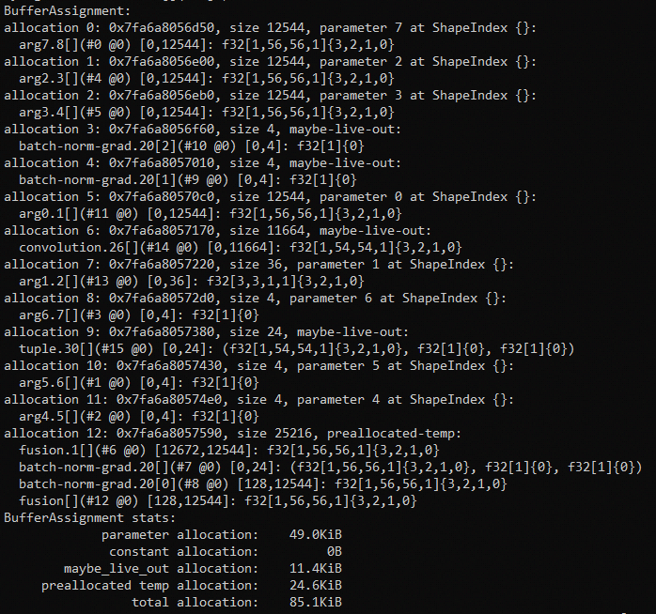
The BufferAssigner
Fragmentation
BufferAssignment is likely have reduced the fragmentation already (global view)
A HeapSimulator to further reduce fragmentation if the buffer being allocated are strictly sequential
Peak memory pressure
HeapSimulator may track memory pressure
Some HLO scheduling pass may help reduce memory pressure
But not used yet in my XLA/tensorflow version for work.
Statistics
Show different allocation and memory pressure

Slide 28
Q & A

Slide 29
Backups
About XLA BufferValue
Every BufferValue is defined by a particular instruction
instructions define only a single BufferValue
Information: instructions defined it, ShapeIndex, color are given
Examples from tensorflow/compiler/xla/service/buffer_value.h:
%add = Add(%foo, %bar)
%tuple_constant = Constant({1, {42, 43}})
%add defines a single array-shaped buffer BufferValue(%add, {}) which holds
the array result of the add operation. The nested-tuple-shaped
%tuple_constant defines 5 buffers described by the following BufferValue
objects:
BufferValue(%tuple_constant, {}) // "Top-level" buffer: vector of
// pointers to BufferValues at
// indices {0} and {1}
BufferValue(%tuple_constant, {0}) // Holds value "1"
BufferValue(%tuple_constant, {1}) // Holds nested tuple: vector of
// pointers to BufferValues at
// indices {1, 0} and {1, 1}
BufferValue(%tuple_constant, {1, 0}) // Holds value "42"
BufferValue(%tuple_constant, {1, 1}) // Holds value "43"

